Slide 1


Planning a Summer HolidAI Introduction to Large Language Models and Generative AI
TUMO Learning Lab - July 2024
Abhiti Vaish

Slide 2
Day 1 July 1, 2024
Monday – Day 1
Welcome!
Activity: Introductions
Lab Overview
Models
Weights + Training
Terms
Types
Foundational v. Open Source
Benchmarking + Leaderboard
Activity: Free Play with Models

Slide 3

Welcome!
Monday – Day 1
Name: Abhiti Vaish
Pronunciation: uh-bhee-thee vay-sh
Occupation: Forward Deployed Software Engineer
Employer: Palantir Technologies
Education: Massachusetts Institute of Technology – Computer Science
Hometowns: New York, USA and Mumbai, India
Background: US Government, healthcare, agriculture, social impact, education

Slide 4

Palantir
Monday – Day 1
Purpose: data enablement / operationalization
Team: AI for US Government
Open Source model enablement and scaling across civil, health, defense
Prior: healthcare tech lead for
Veterans Health Administration (VHA), Dept. of Veterans Affairs (VA)
Administration for Strategic Preparedness and Response (ASPR), Dept. Health and Human Services (HHS)

Slide 5

Introductions
Monday – Day 1
Introduce yourself to your neighbors
Name
Experience/interest level in software
Your definition of a model
Favorite ice cream flavor
1 place you’d love to travel to + why
Introduce yourself to whole lab

Slide 6

Project - Premise
Monday – Day 1
You’re going on holiday!
Solo, with family, or with friends – you pick
You leave tomorrow
You have no plans yet
What do you consider when planning a trip?

Slide 7
Project - Premise
Monday – Day 1
You desperately need guidance on…
What to eat
Where to go
New/Local events
What to pack

Slide 8
Project - Implementation
Monday – Day 1
Task: a web application that helps plan a holiday for you
Day-by-day itinerary
Packing list
Minimum Requirements:
Input text box (where user prompts the LLM to respond with an itinerary and packing list, customized for a specified city and group)
Rendered text (displaying the LLM’s response) in a human readable format

Slide 9
Project - Implementation
Monday – Day 1
Other Suggestions:
Itinerary contains current events (pulled from local news)
Common phrases in local language
Information about local public transit
Images of locations mentioned in suggested itinerary
Several tabs (one each for itinerary, packing list)

Slide 10
Project - Deliverable
Monday – Day 1
Given:
Boilerplate React web application
Access to a large language model (via REST API)
Due: Day 10 (Fri, July 12)
In-class 10-minute presentation / student
You must implement the “Minimum Requirements”
With remaining time, consider implementing the “Other Suggestions” (or any other features you’d like)
Get creative!

Slide 11
Lab Overview
Monday – Day 1
Week 1: Models and Generative AI
Day 1: Model Fundamentals
Day 2: Language Model Prompting
Day 3: Model Spectrum
Day 4: Ethics
Day 5: (no class)
Week 2: WebApp development
Day 6: Frontend Development
Day 7: REST APIs
Day 8: project work
Day 9: project work
Day 10: project presentations

Slide 12
Lab Best Practices
Monday – Day 1
Ask as many questions as you have!
Ask me or your peers as they arise
Also feel free to use ChatGPT
Activities highlighted like this signifies a hands-on activity
We will aim to take a 20 minute break ~half-way through each lab

Slide 13
Models
Monday – Day 1
Weights + Training
Terms
Types
Foundational v. Open Source
Benchmarking + Leaderboard

Slide 14
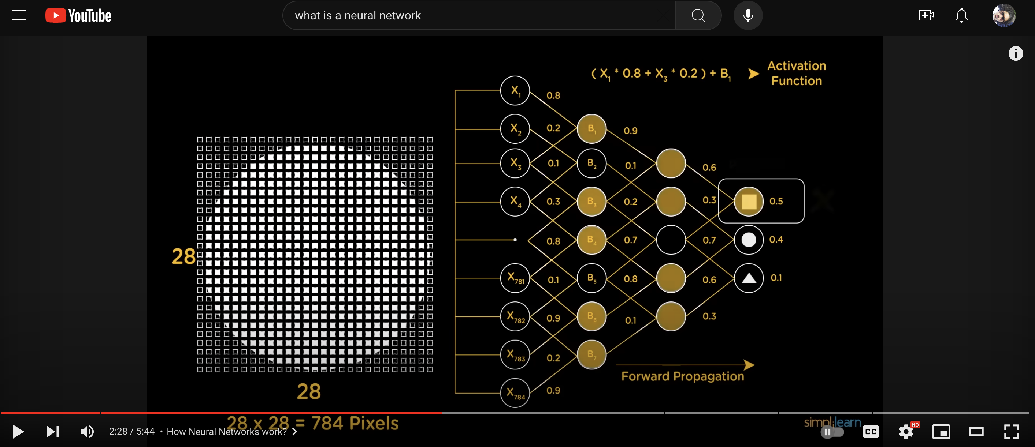
Monday – Day 1
Models
Notes:
https://www.youtube.com/watch?v=bfmFfD2RIcg

Slide 15
Models – Training + Weights
Monday – Day 1
A model is a decision tree, with weighted branches (based on training phase)
Toy example: navigating the corridors in TUMO center to get to lab
Start at entrance. At each moment, you can take one of these steps: (1) walk forward, (2) go up a level, (3) turn right, (4) turn left
As a newcomer (with no help), each of these four possible steps seem equally likely, so you weight them each ¼ = 0.25
Each day you reach the lab you log the steps taken to get here
You may not be able to take the same route each day (eg. Elevator is broken, stairs are blocked)
Next time a newcomer joins, they will effectively have suggestions on how to get to lab (and will get there quicker than you did)

Slide 16
Models – Training + Weights
Monday – Day 1
Models go through phases:
(1) Training: you give the model inputs and the target value (what the model should predict from those inputs).
Eg. Input: [(1), (3), (2), (2), (1)] = lab room
Eg. Input: [(2), (1), (2), (4), (1)] = offices
In rounds (iteratively) it adjusts the model weights based on how far from the target value the model’s predicted output is.
(2) Testing: you give the model input, and it outputs a prediction (“model inference”)

Slide 17
Models – Training + Weights
Monday – Day 1
Training must precede Testing in order for the model to be useful
Once training is completed, you have your model = a decision tree with paths weighted based on the training data

Slide 18
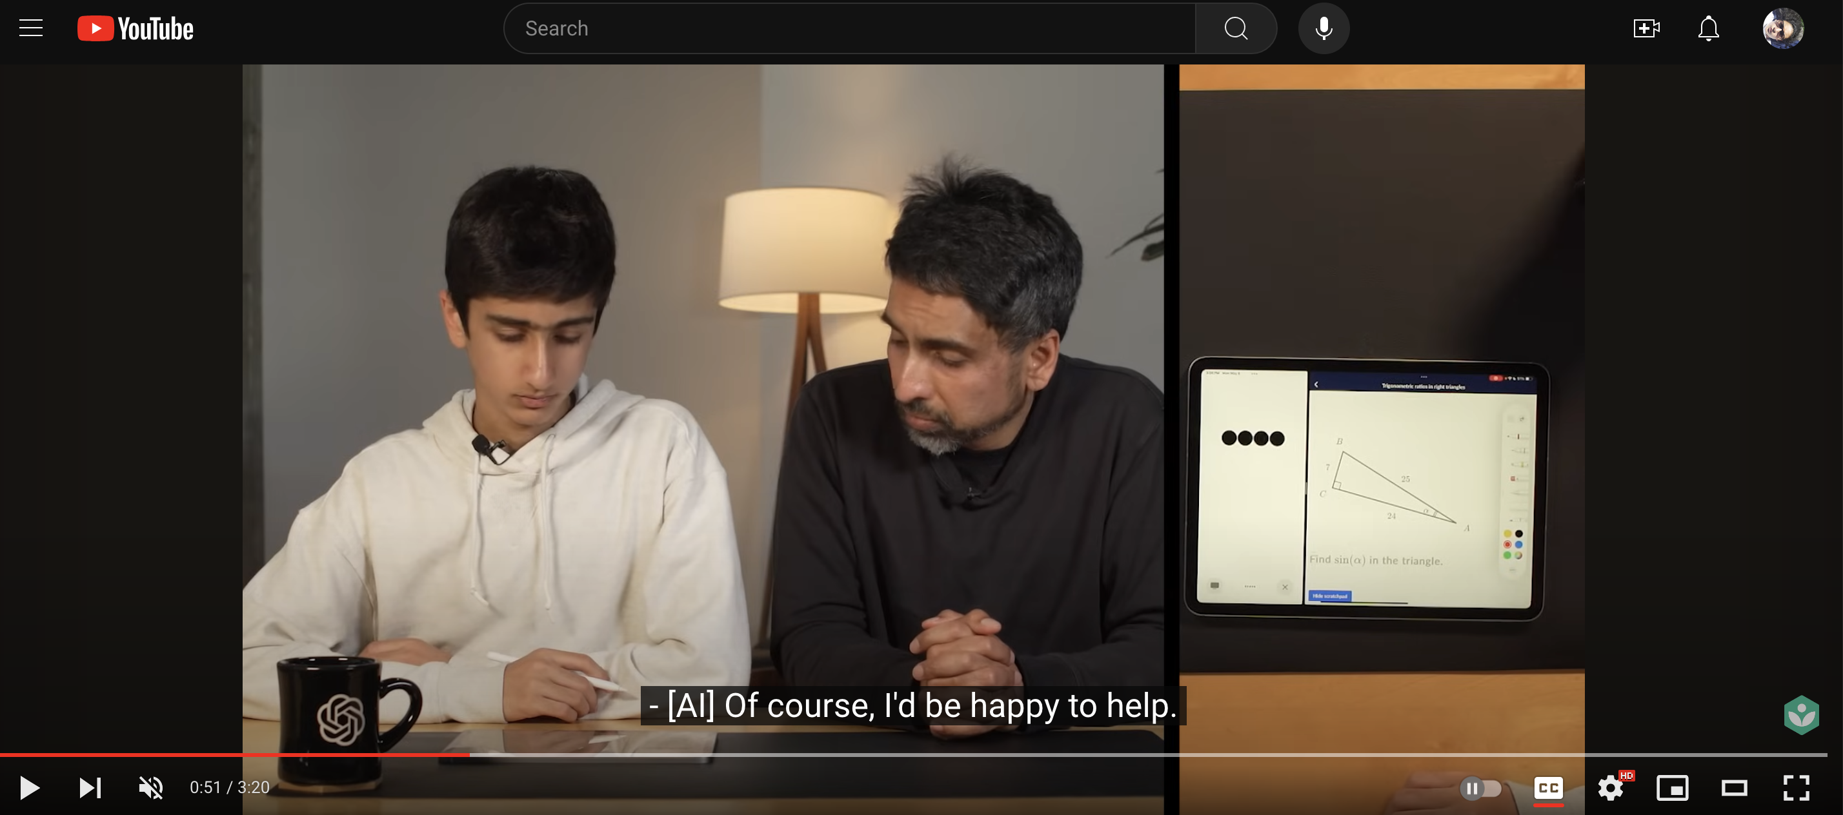
Monday – Day 1
Multi-Modal
Notes:
https://www.youtube.com/watch?v=IvXZCocyU_M

Slide 19
Models - Terms
Monday – Day 1
Artificial Intelligence (AI): enabling machines to accomplish tasks that usually humans must tackle
Machine Learning (ML): subset of AI, focused on enabling machines to iteratively get better at tasks
Supervised Learning: defined set of inputs + values that a model is trained on
Reinforcement Learning: “trial-and-error” training of model
Generative AI (GenAI): AI that outputs new content

Slide 20
Models - Types
Monday – Day 1
Language: GenAI trained on text and generates text
Embedding: converts chunks of text into n-dimensional numerical vectors. Makes it easy to compare text.
Vision: input is image or video pixel frames, typically outputting text (analyzing the input)
Transcription: input is audio, output is text
Translation: input is text in one language, output is text in a different language
Multi-modal: model that takes a variety of types of input (eg. Text and image)

Slide 21
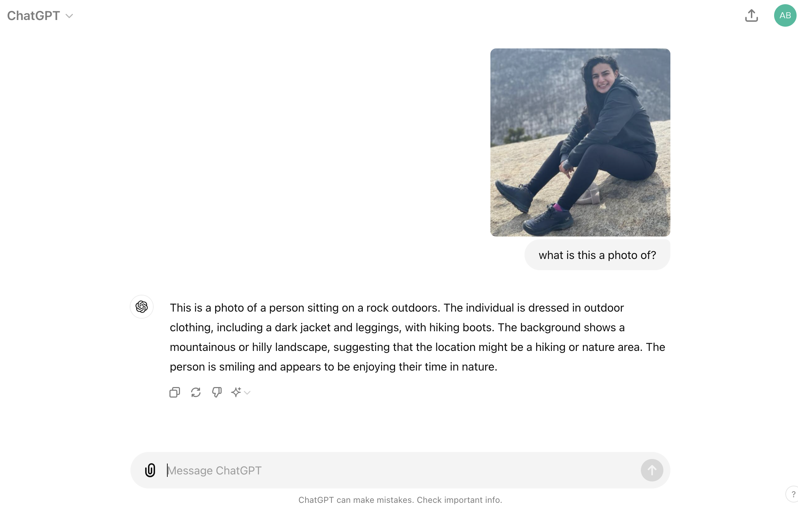
Monday – Day 1
Vision

Slide 22
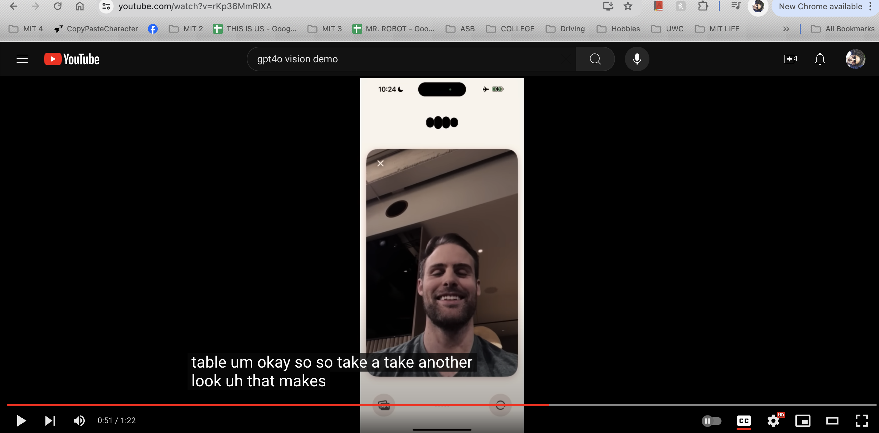
Monday – Day 1
Vision
Notes:
https://www.youtube.com/watch?v=rKp36MmRlXA

Slide 23
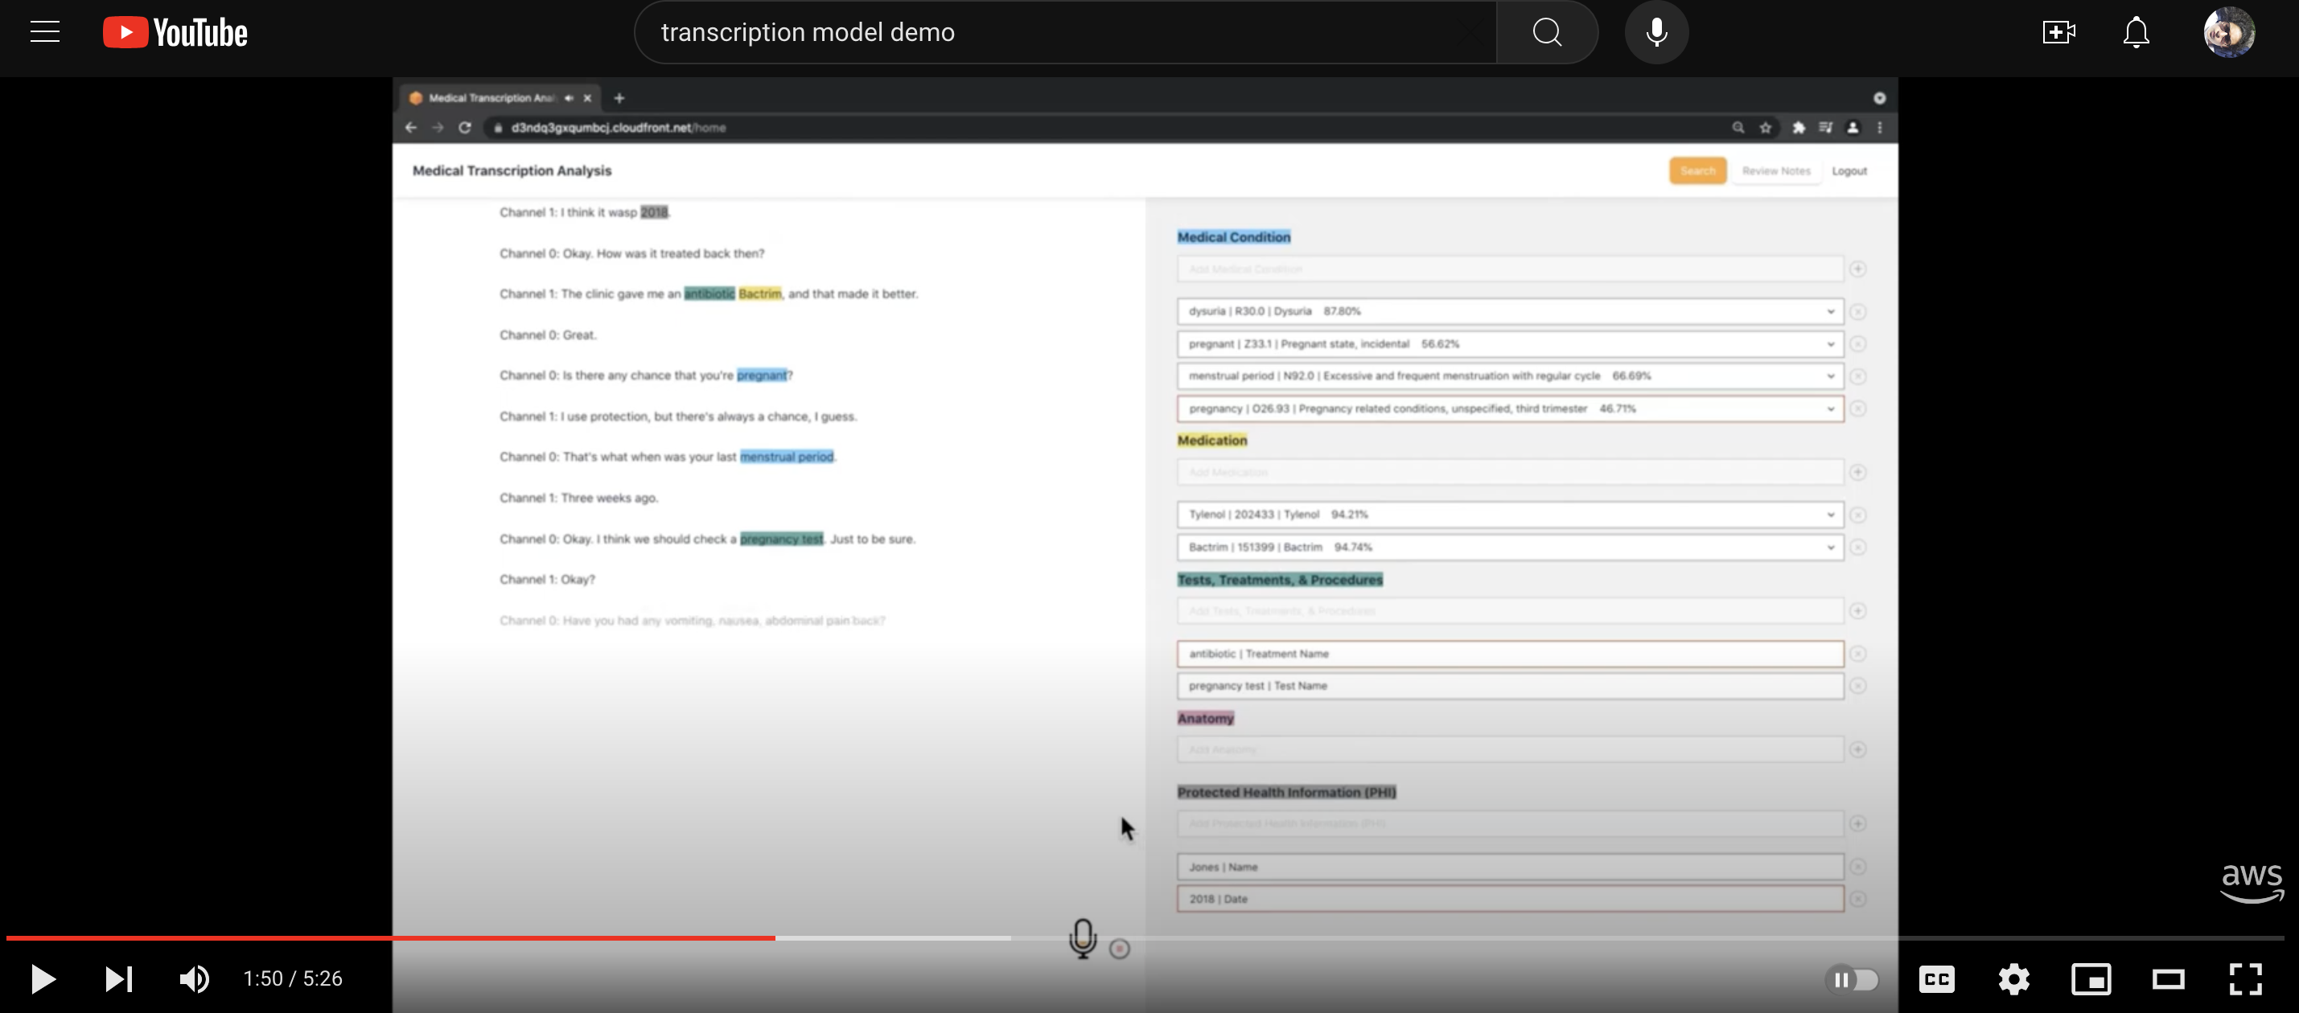
Monday – Day 1
Transcription
Notes:
https://www.youtube.com/watch?v=f5HVIALG5g4

Slide 24
Models – Terms Cont’d
Monday – Day 1
Neural Net (NN): models meant to simulate how humans think
Natural Language Processing (NLP): (subset of NN) tools to help machines understand and predict language in the way humans speak (“natural”)
Large Language Model (LLM): (subset of NLP) a type of NN trained on a massive corpus of text-based data, used to predict text
Token: atomic unit of language that the LLM functions at (could be a character, a substring of a word, a word)

Slide 25
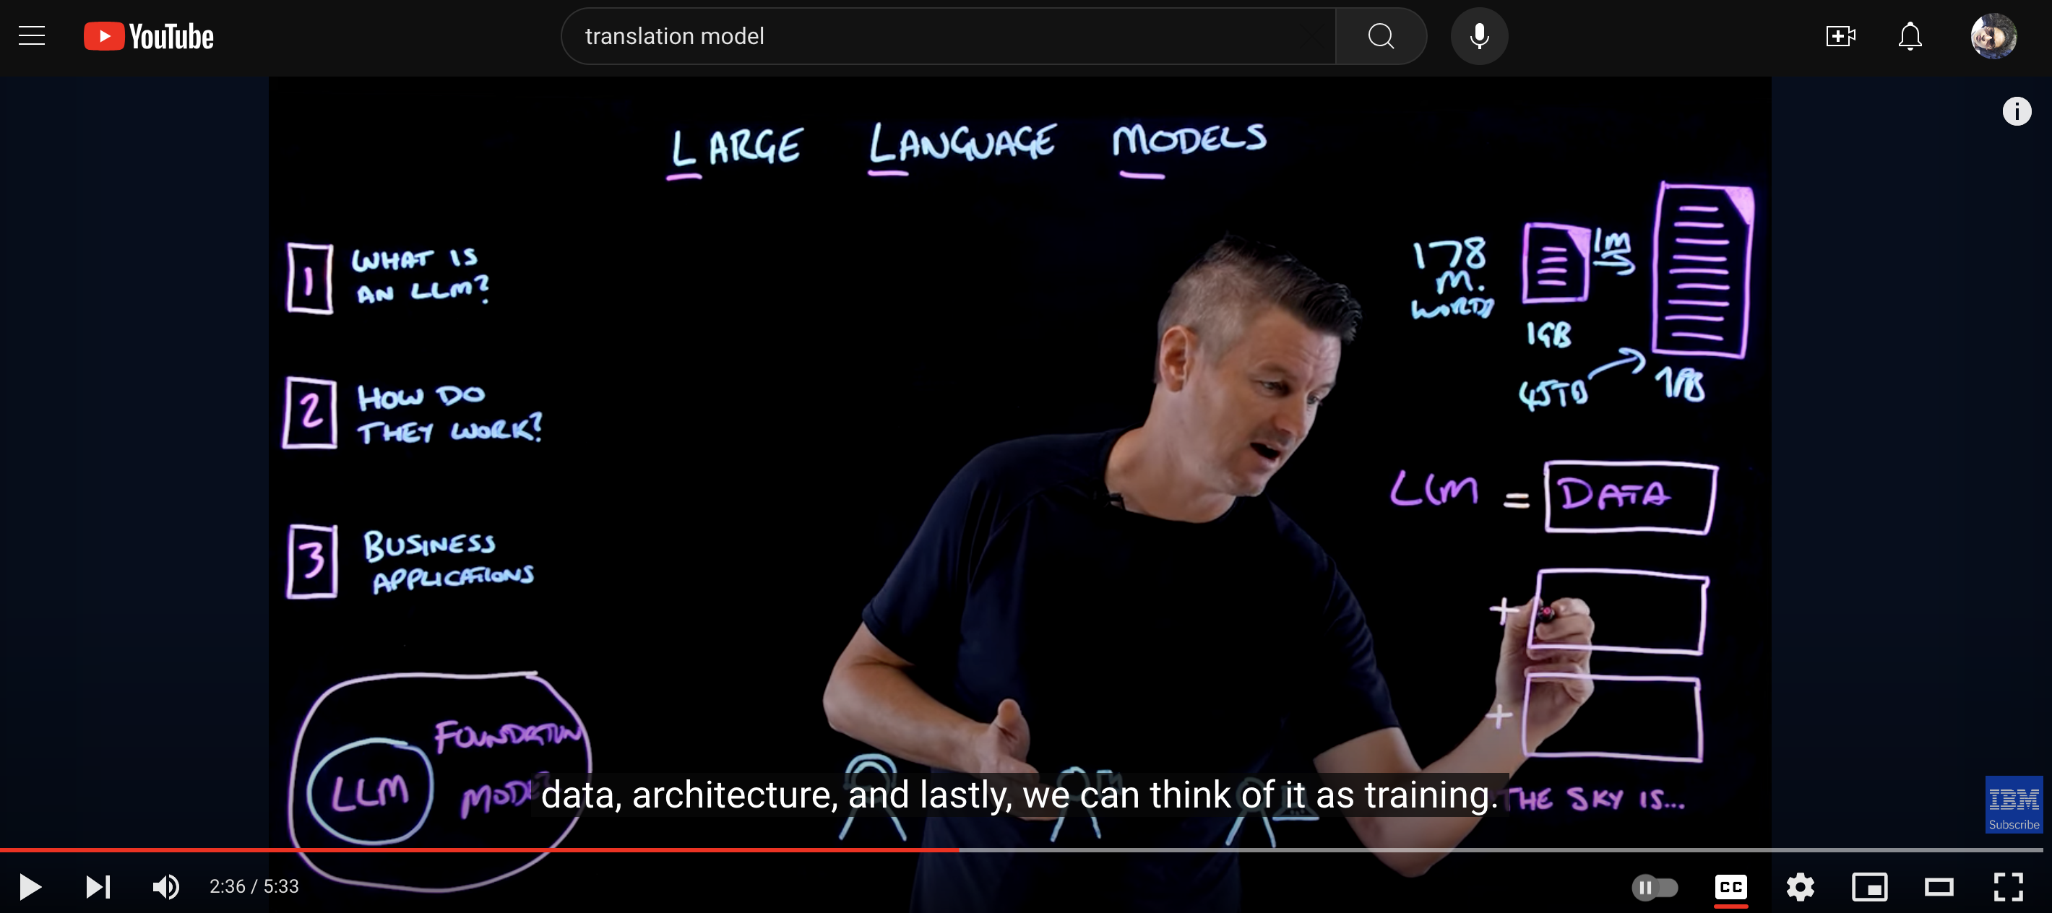
Monday – Day 1
Language

Slide 26
Models –Foundational v. Open Source
Monday – Day 1
Foundational Models
Core models upon which further “fine-tuning” for specific tasks is completed
Often also closed-source
Examples: GPT, Claude
Open Source Models
Source code and/or model weights publicly available
Allows for greater scrutiny/accreditation as well as collaboration
Examples: Llama3, Mixtral

Slide 27
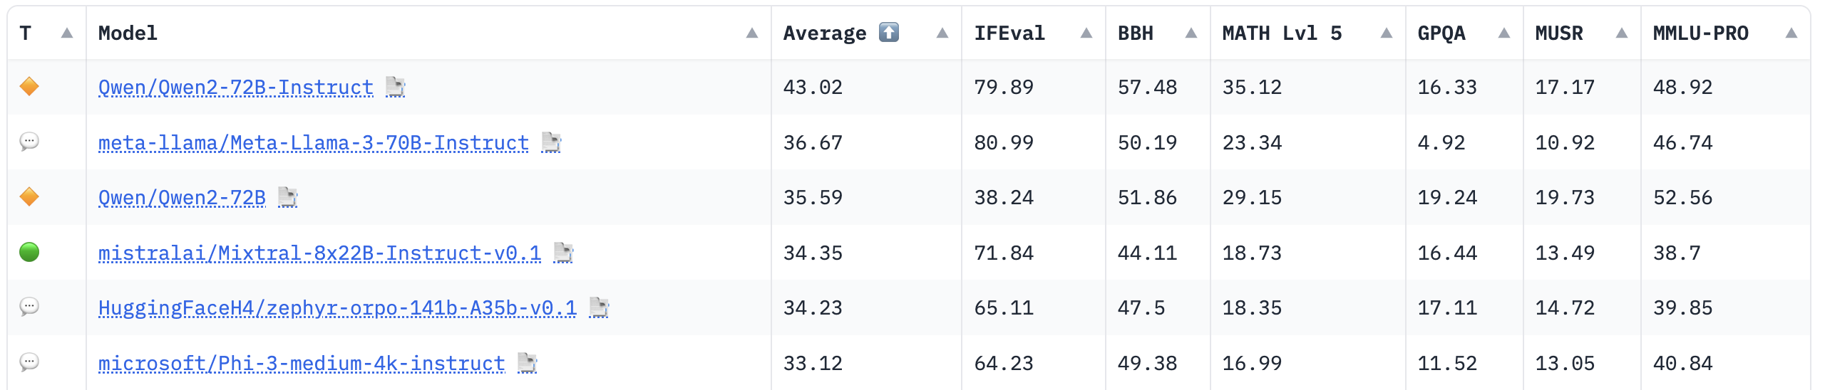
Models – Benchmarking + Leaderboard
Monday – Day 1
Benchmarking
The “standardized tests” for models
Quantitative: accuracy, precision, recall, F1-score, etc.
Eg. Compare how good each LLM is at performing classification
Leaderboard
The “best-in-class” for models
HuggingFace for open source models

Slide 28

Free Play with Models
Monday – Day 1
Try: informational query
Try: creative task (eg. write me a haiku about…)
Try: categorization
Try: summarization
Try: Entity Extraction
Try: same task using different models - explain the difference

Slide 29
Day 2 July 2, 2024
Tuesday – Day 2
Different Models
Activity: Model Prompting
Prompt Engineering
Activity: Model Prompting
Controlled Generation
Activity: Model Prompting
Figma
Activity: Development Environment Setup
Cloning Github repo
Installing React

Slide 30
Recap
Tuesday – Day 2
What is a model?
What is a large language model (LLM)?
What are some of the types tasks you can prompt an LLM for?

Slide 31
Free Play with Models
Tuesday – Day 2
GPT (from OpenAI)
Llama (from Meta)
Mixtral (from Mistral)
Claude (from Anthropic)
Aggregated @ Vello
Try: informational query

Slide 32
Free Play with Models
Tuesday – Day 2
GPT (from OpenAI)
Llama (from Meta)
Mixtral (from Mistral)
Claude (from Anthropic)
Aggregated @ Vello
Try: creative task

Slide 33
Free Play with Models
Tuesday – Day 2
GPT (from OpenAI)
Llama (from Meta)
Mixtral (from Mistral)
Claude (from Anthropic)
Aggregated @ Vello
Try: categorization

Slide 34
Free Play with Models
Tuesday – Day 2
GPT (from OpenAI)
Llama (from Meta)
Mixtral (from Mistral)
Claude (from Anthropic)
Aggregated @ Vello
Try: summarization

Slide 35
Free Play with Models
Tuesday – Day 2
GPT (from OpenAI)
Llama (from Meta)
Mixtral (from Mistral)
Claude (from Anthropic)
Aggregated @ Vello
Try: entity extraction

Slide 36
Prompt Engineering
Tuesday – Day 2
LLMs are trained to interpret and generate human-like speech
But -- every human (and model!) thinks differently
Prompt Engineering: adjusting the wording (in SYSTEM or USER) to help the LLM think and output closer to desired output (ASSISTANT)

Slide 37
Prompt Engineering - Roles
Tuesday – Day 2
SYSTEM: instructions to the LLM about what role it is supposed to fill
“You are a helpful, unbiased assistant. You are functioning as a travel coordinator helping tourists navigating a new city.”
USER: specific ask / task for the LLM to perform
“Specify the next 4 bus arrival times at the stop near the airport in Brussels that can take me to the Park Inn hotel.”
ASSISTANT: response from the model
“Welcome to Brussels! You can take the M454 bus to get to the Park Inn hotel. The 4 next arrival times are: 14:21, 14:56, 15:12, 15:40. To get to the bus stop, go to the arrivals level (one floor below departure) and follow the yellow signs to baggage claim. Take a right upon exit from the airport and look for the green bus stop sign.

Slide 38
Prompt Engineering – Examples (SYSTEM)
Tuesday – Day 2
SYSTEM: instructions to the LLM about what role it is supposed to fill
FINE: “You are the chat-based assistant for Google Maps”
BETTER: “You are a helpful, unbiased assistant. You are functioning as a travel coordinator helping tourists navigating a new city. Answer their questions directly first, but offer additional context and visual cues to help them navigate an unfamiliar environment. If you do not understand what they mean, as for clarification rather than trying to give them an answer.”

Slide 39
Prompt Engineering – Examples (USER)
Tuesday – Day 2
USER: specific ask / task for the LLM to perform
FINE: “Specify the next 4 bus arrival times at the stop near the airport in Brussels that can take me to the Park Inn hotel.”
BETTER: “Specify the next 4 bus arrival times at the stop near the airport in Brussels that can take me to the Park Inn hotel. Please also provide me with numerical steps on how to get to the right bus stop and how to identify if the bus is the correct one.”

Slide 40
Model Prompting
Tuesday – Day 2
Use any 2 models of your choosing:
GPT (from OpenAI)
Llama (from Meta)
Mixtral (from Mistral)
Claude (from Anthropic)
Aggregated @ Vello
(1) send a prompt with free-text (as you may ask a friend or tutor)
(2) send a prompt, specifying an output format (eg. “output the date in the format yyyy-MM-dd”)

Slide 41
Controlled Generation
Tuesday – Day 2
To help the LLM think even more clearly, can ask it to return it’s answer in a tightly structured format
JSON

Slide 42
Controlled Generation - JSON
Tuesday – Day 2
JSON: look-up table between key-value pairs
Specify the types of each output (or not)
{“time”: 2024-06-30, “responses”: [{“color”: “red”, “shape”: “circle”, “count”: 44}, {“color”: “purple”, “shape”: “diamond”, “count”: 12}]}

Slide 43
Controlled Generation – JSON Prettified
Tuesday – Day 2
Make more reader-friendly, easier to catch formatting bugs
{
“time”: 2024-06-30,
“responses”: [
{“color”: “red”,
“shape”: “circle”,
“count”: 44},
{“color”: “purple”,
“shape”: “diamond”,
“count”: 12}
]
}

Slide 44
Controlled Generation – JSON types
Tuesday – Day 2
Make more reader-friendly, easier to catch formatting bugs
{
“time”: date,
“responses”: [
{“color”: string,
“shape”: string,
“count”: int},
{“color”: string,
“shape”: string,
“count”: int}
]
}
{
“time”: 2024-06-30,
“responses”: [
{“color”: “red”,
“shape”: “circle”,
“count”: 44},
{“color”: “purple”,
“shape”: “diamond”,
“count”: 12}
]
}

Slide 45
JSON Generation
Tuesday – Day 2
Write a JSON about yourself, with the following keys:
Your name
Your birthday
Your 2 favorite musicians
Your siblings’ names and matching ages
Specify the “type” for each key (one of string, date, integer, array (of), dictionary (of))
Notes:
{
"name" : "Abhiti Vaish",
"birthday": 1997-12-19,
"favorite_musicians": ["The Lumineers", "Mumford and Sons"],
"siblings": [{"name": "Pranav Vaish", "age": 23}, {"name": "Kanika Vaish", "age": 28}]
}
{
"name" : string,
"birthday": date,
"favorite_musicians": [string],
"siblings": [{string, int}]
}

Slide 46
Controlled Generation - Request
Tuesday – Day 2
SYSTEM: instructions to the LLM about what role it is supposed to fill
“You are a helpful, unbiased assistant. You are functioning as a travel coordinator helping tourists navigating a new city.
USER: specific ask / task for the LLM to perform
“Specify the next 4 bus arrival times at the stop near the airport in Brussels that can take me to the Park Inn hotel. Return the output in the following JSON format: {“next_arrival_times”: [hh:mm], “other_information”: string}”
ASSISTANT: response from the model
{“next_arrival_times”: [14:21, 14:56, 15:12, 15:40],
“other_information”: “Welcome to Brussels! You can take the M454 bus to get to the Park Inn hotel. To get to the bus stop, go to the arrivals level (one floor below departure) and follow the yellow signs to baggage claim. Take a right upon exit from the airport and look for the green bus stop sign.” }

Slide 47
Model Prompting – Controlled Gen
Tuesday – Day 2
Use any 2 models of your choosing:
GPT (from OpenAI)
Llama (from Meta)
Mixtral (from Mistral)
Claude (from Anthropic)
Aggregated @ Vello
(3) send a prompt, specifying a JSON format as output

Slide 48

Figma
Tuesday – Day 2
High-fidelity frontend mock-up of an application
“Let me quickly show you what it should look like”
“Let me quickly show you how the user experience should feel”

Slide 49
Figma - User Interface
Tuesday – Day 2
User Interface (UI):
What does the application look like?
How do people interact with the buttons / images / text
User Experience (UX):
How easily is a user able to complete an end-to-end action/workflow
How easily can a user get help / oriented around the entire applications

Slide 50
Figma - Concepts
Tuesday – Day 2
Frame – infrastructure/ setting for mock (eg. iPhone 14)
Layer – text, shape, line
Group – scalable/resizable entity (combo of any things within, bounds defined by things contained within)
Component – reusable elements (main v instance); can start with layers/groups/frames; detach breaks the hierachy

Slide 51
Figma – Building a Mock
Tuesday – Day 2
Library: main components to be reused as instances
Can use general
Screenshots:
Low-fidelity (lo-fi) > High-fidelity (hi-fi)

Slide 52
Figma – Buildering a Prototype
Tuesday – Day 2
Toggle from “Design” tab to “Prototype” tab
Connect layers to one another with conditions (eg. “On-Click”)

Slide 53
Figma Prototyping
Tuesday – Day 2
Design your holiday planning webapp user interface
Remember to include (at minimum):
A text box where the prompt can be entered
A button
A text space where the response can be viewed

Slide 54
Day 3 July 3, 2024
Wednesday – Day 3
0-shot
Activity: 0-shot prompting
Retrieval Augmented Generation (RAG)
Activity: Prompting with Context
Activity: Perform RAG
Fine-Tuning
Search Types

Slide 55
Model Spectrum
Wednesday – Day 3
As with everything, scarcity exists
Make use of existing models, but ”customize” to your use case
If the customized model is still not good enough, make one for your use case

Slide 56
Model Spectrum
Wednesday – Day 3
As with everything, scarcity exists
Use existing models, where possible
Can “customize” existing models to varying extents
Few-shot
Prompting
0-shot
Prompting
Fine-tuning
Retrieval
Augmented
Generation

Slide 57
Model Spectrum- Prompting
Wednesday – Day 3
0-shot Prompting: prompt a model, understanding it is responding based off only the data it was trained on (whenever that was)
Few-shot Prompting: prompt a model, look at its response, re-prompt the model. With each iteration you understand how it thinks a bit more and can re-approach the prompt, as needed.

Slide 58
Model Prompting – Few-shot
Wednesday – Day 3
Use any 2 models of your choosing:
GPT (from OpenAI)
Llama (from Meta)
Mixtral (from Mistral)
Claude (from Anthropic)
Aggregated @ Vello
(1) Send a prompt, see the output
(2) Send a few prompts iteratively, see the output

Slide 59
Model Spectrum- RAG
Wednesday – Day 3
Retrieval Augmented Generation (RAG): in the prompt to an LLM, provide additional context
New data: information that has occurred since the model was trained
Privileged data: information the general LLM was not trained on because it was not accessible to the model
Note: be careful about sharing secrets!
GPT3.5 – oldie but goodie (March 2023)

Slide 60
Model Prompting – RAG
Wednesday – Day 3
Use any 1 model of your choosing:
GPT (from OpenAI)
Llama (from Meta)
Mixtral (from Mistral)
Claude (from Anthropic)
Aggregated @ Vello
(1) Send a prompt (about something after early 2023), see the output
(2) Send a few prompts with additional context, see the output
Notes:
https://www.wunderground.com/history/monthly/in/mumbai/VABB/date/2023-7

Slide 61
Model Spectrum- Fine-Tuning
Wednesday – Day 3
Fine-Tuning: take a foundational model and further train it to be very good at a specific task

Slide 62
Model Spectrum- Searches
Wednesday – Day 3
Keyword search: pass a search term and find exact references to it
Eg. Google Search

Slide 63
Model Spectrum- Searches
Wednesday – Day 3
Semantic search: pass a search term and find references that intend the same thing (but the exact words may differ)
Embedding + Language models = Semantic Search
Text chunks passed into embedding model => several n-dimensional vector of decimals
Search term (text) passed into embedding model => single n-dimensional vector of decimals
Find the k nearest neighbors using some similarity function (eg. Cosine similarity)
Serve the text chunks that map to the k-nearest neighbors as search results

Slide 64
Day 4 July 4, 2024
Thursday – Day 4
Figma mocks
RAG
Activity: Prompting
Searches
Model Training Bias
Privacy / Ethical Use
Activity: Model Acceptable Use Policy (AUP)
Activity: Case Study
Homework: Share project idea with Abhiti

Slide 65
Figma Prototyping
Thursday – Day 4
Design your holiday planning webapp user interface
Remember to include (at minimum):
A text box where the prompt can be entered
A button
A text space where the response can be viewed

Slide 66
Model Spectrum
Thursday – Day 4
As with everything, scarcity exists
Use existing models, where possible
Can “customize” existing models to varying extents
Few-shot
Prompting
0-shot
Prompting
Fine-tuning
Retrieval
Augmented
Generation

Slide 67
Model Spectrum- Prompting
Thursday – Day 4
0-shot Prompting: prompt a model, understanding it is responding based off only the data it was trained on (whenever that was)
Few-shot Prompting: prompt a model, look at its response, re-prompt the model. With each iteration you understand how it thinks a bit more and can re-approach the prompt, as needed.

Slide 68
Model Spectrum- RAG
Thursday – Day 4
Retrieval Augmented Generation (RAG): in the prompt to an LLM, provide additional context
New data: information that has occurred since the model was trained
Privileged data: information the general LLM was not trained on because it was not accessible to the model
Note: be careful about sharing secrets!
GPT3.5 – oldie but goodie (March 2023)

Slide 69
Model Prompting – RAG
Thursday – Day 4
Use any 1 model of your choosing:
GPT (from OpenAI)
Llama (from Meta)
Mixtral (from Mistral)
Claude (from Anthropic)
Aggregated @ Vello
(1) Send a prompt (about something after early 2023), see the output
(2) Send a few prompts with additional context, see the output
Notes:
https://www.wunderground.com/history/monthly/in/mumbai/VABB/date/2023-7

Slide 70
Model Spectrum- Fine-Tuning
Thursday – Day 4
Fine-Tuning: take a foundational model and further train it to be very good at a specific task

Slide 71
Model Spectrum - Summary
Thursday – Day 4
As with everything, scarcity exists
Make use of existing models, but ”customize” to your use case
If the customized model is still not good enough, make one for your use case

Slide 72
Searches
Thursday – Day 4
Keyword search: pass a search term and find exact references to it
Eg. Google Search

Slide 73
Model Spectrum- Searches
Thursday – Day 4
Semantic search: pass a search term and find references that intend the same thing (but the exact words may differ)
Embedding + Language models = Semantic Search
Text chunks passed into embedding model => several n-dimensional vector of decimals
Search term (text) passed into embedding model => single n-dimensional vector of decimals
Find the k nearest neighbors using some similarity function (eg. Cosine similarity)
Serve the text chunks that map to the k-nearest neighbors as search results

Slide 74

Model Spectrum- Embedding Model
Thursday – Day 4
In Senegal the national food is…
[9,08,123,…]
In Senegal the currency is…
[9,02,124,…]
In Peru the national food is…
[32, 24, 123, …]

Slide 75
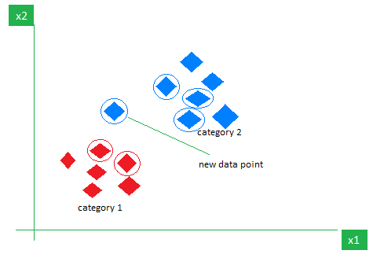

Model Spectrum- Embedding Model
Thursday – Day 4
In Senegal the national food is…
In Senegal the currency is…
In Senegal …
In Peru the national food is…

Slide 76
Model Bias - Training
Thursday – Day 4
LLMs are trained on a (large) corpus of data
It learns how to think based off this data
eg. “the sky is purple”
If the data is incorrect, the responses will be incorrect
“garbage in, garbage out”

Slide 77
Model Bias - Tone
Thursday – Day 4
LLMs anticipate the next word
It adopts the tone of the content it is trained on
Overfitting
Eg. If only hateful text, it will respond with hostility and suggest aggressive paths forward

Slide 78
Model Bias - Hallucination
Thursday – Day 4
LLMs expect themselves to output a solution
If one doesn’t exist, it will try to make one up
It wants to be successful (not helpful nor malicious)
In anticipating the next word, it can continue on to complete train of thought
Think about how sometimes your mouth starts a sentence and your brain goes on auto-pilot to complete it
It may think it knows what you are talking about but is off
Think about how you overhear a bit of information and jump in on a conversation, but are completely off base
Think about how you think you recall a concept you have learned, but actually remember it incorrectly
Prompt engineering is critical to curb this behavior

Slide 79
Model Prompting – Preventing Hallucination
Thursday – Day 4
Use any 1 model of your choosing:
GPT (from OpenAI)
Llama (from Meta)
Mixtral (from Mistral)
Claude (from Anthropic)
Aggregated @ Vello
(1) Send a prompt about something very specific about TUMO and see the output
(2) Send the same prompt as (1), but tell the model to return “I don’t know” if it doesn’t know

Slide 80
Privacy
Thursday – Day 4
Models aren’t trained on everything
Can’t (shouldn’t?) have access to your TikTok FYP or your online shopping behaviour
Many models will re-train based on data passed into it
Model responses sound/look authoritative
Models designed to mimic human thought/expression
Highly convincing
Use public data (or other sources) to be most impressive
Can lead to spread of misinformation: Deep Fakes

Slide 81
Privacy – Deep Fake
Thursday – Day 4
Case study: Indian elections
Others: Ransom notes

Slide 82
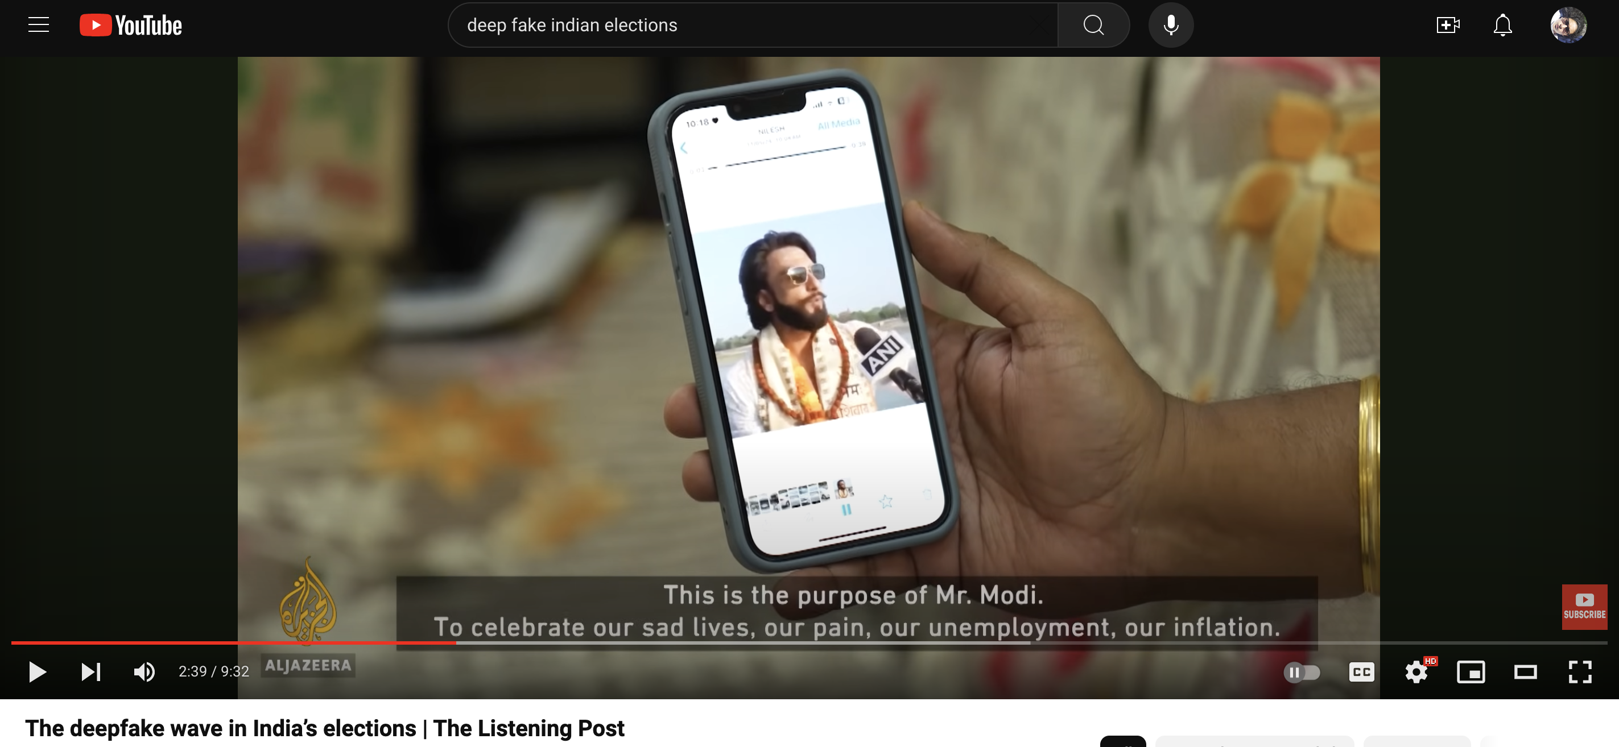
Thursday – Day 4
Deep Fake
Notes:
https://www.youtube.com/watch?v=V_NN13Eu8yc

Slide 83
Privacy – Humans v Machines
Thursday – Day 4
But aren’t humans flawed?
Yes, we are flawed and exude and perpetuate biases
These biases are shared and used to train models
But aren’t machines logical?
Yes, but sometimes to a fault
Can overly focus on executing the task
Struggle to adjudicate if the task should be executed in the first place

Slide 84
Ethical Use – Acceptable Use Policy (AUP)
Thursday – Day 4
GPT
Protecting minors
Llama
Meta Llama models cannot be used to harm people
Can defense agencies use these models?
Claude

Slide 85
Ethical Use – Human in the Loop
Thursday – Day 4
AI-powered fully automated future?
Hopefully not.
AI is meant to speed up the process, and help provide novel insights to humans – who ultimately make the decision
Humans also are trained on specific data, but are also held accountable and are continually retraining
Humans should be in the drivers seat
Example: emails can be drafted by AI but proofed by humans

Slide 86
Day 5 July 5, 2024
Friday – Day 5
Constitution Day (no session)

Slide 87
Day 6 July 8, 2024
Monday – Day 6
Frontend Development
HTML
Activity: Inspect HTML
CSS
Activity: Inspect HTML
React
Activity: Getting Started
GitHub
Activity: Explore Repositories
Dev environment setup
Activity: GitHub cloning
Activity: React Getting Started

Slide 88
HTML
Monday – Day 6
HyperText Markup Language (HTML)
Composed of many tags
Tags: standard components frequently used on internet
HTML:
View content
Share content
Interact with content

Slide 89
HTML
Monday – Day 6
Define divs
Hierarchical via nesting

Slide 90
HTML tags
Monday – Day 6
Claim a tag (below) and present it
<embed>: Abhiti

Slide 91
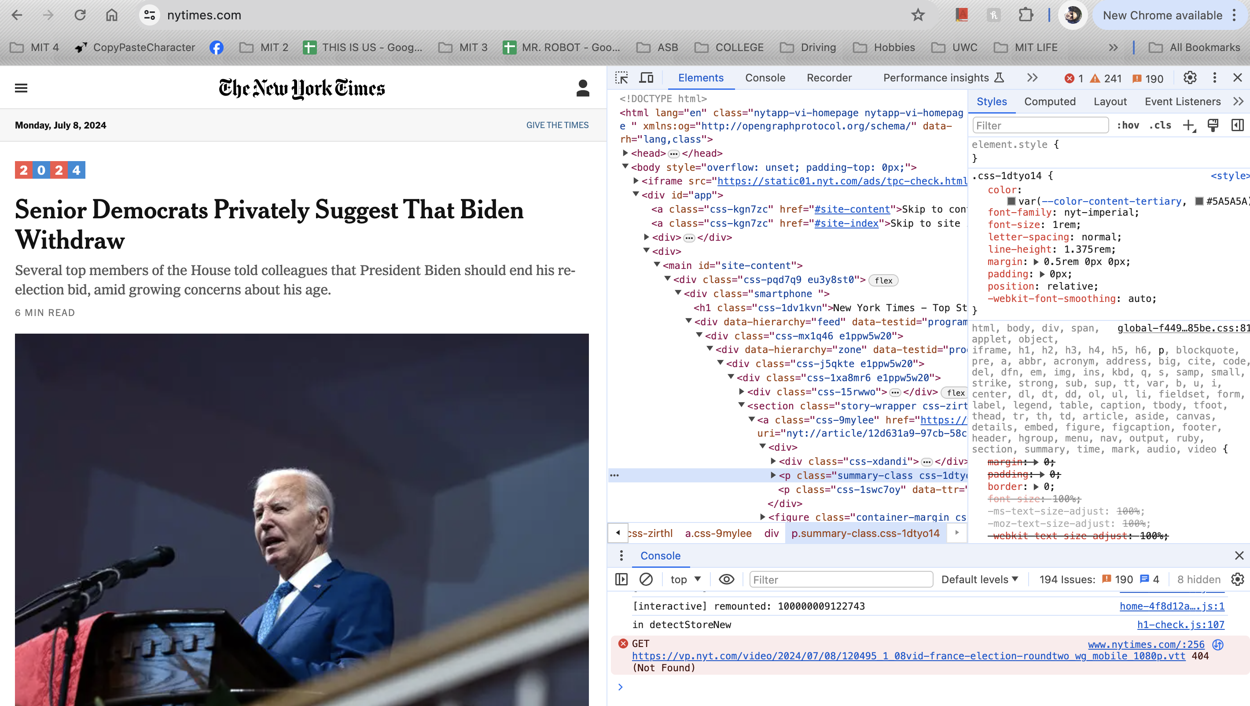
Inspect HTML
Monday – Day 6
Open your favorite website and inspect the code behind it

Slide 92
CSS
Monday – Day 6
Cascading Style Sheet
Common elements
Override
Hierarchical via definition

Slide 93
Inspect CSS
Monday – Day 6
Open your favorite website and inspect the CSS behind it

Slide 94
React
Monday – Day 6
Developed by Meta
Allows you to run a server and hit APIs
Define HTML and CSS cleanly
Library: Blueprint
Specific component

Slide 95
Development Environment Setup
Monday – Day 6
https://www.freecodecamp.org/news/how-to-install-react-a-step-by-step-guide/

Slide 96
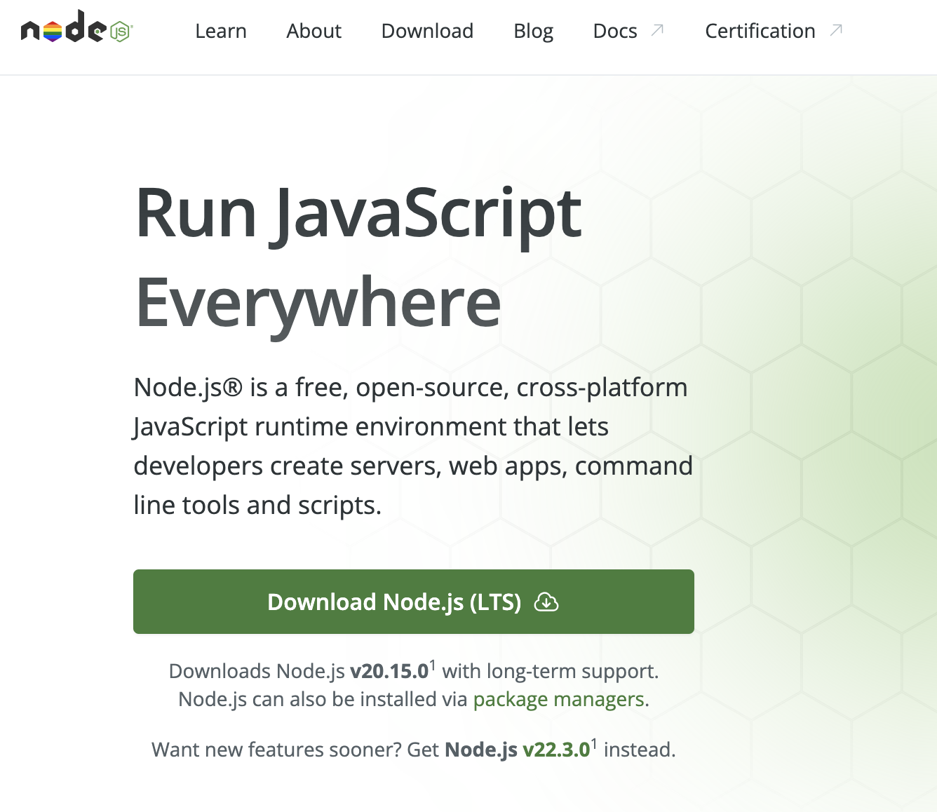
Dev Env Setup
Monday – Day 6
Node JS
Get recommended version from the website
This will get you npm and npx
Open Terminal application
$ node –v
Ensure version is v20 (or higher)

Slide 97
Dev Env Setup
Monday – Day 6
React
$ npx create-react-app tumo-summer-adventure
$ ls
$ cd tumo-summer-adventure
$ pwd
$ npm start
Create the basic React application
Show me everything in the current folder
$ cd tumo-summer-adventure
$ pwd
$ npm start

Slide 98
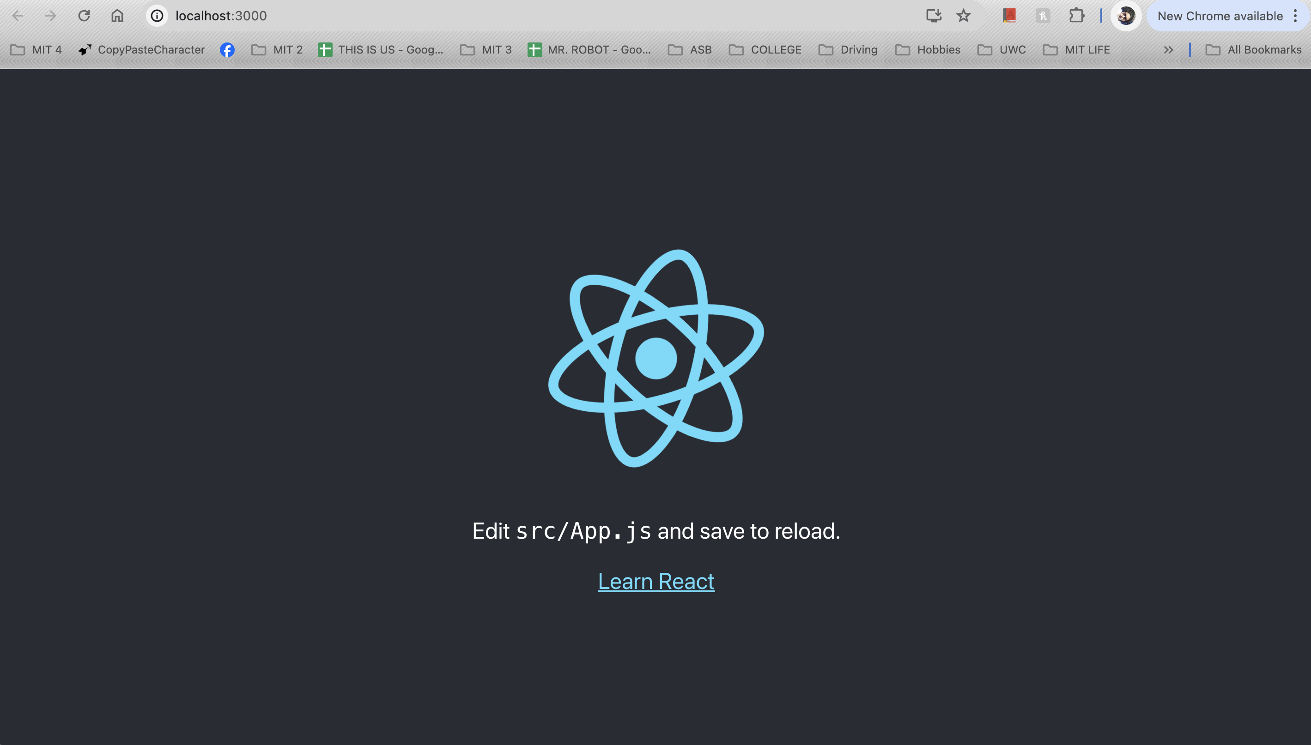
Monday – Day 6

Slide 99
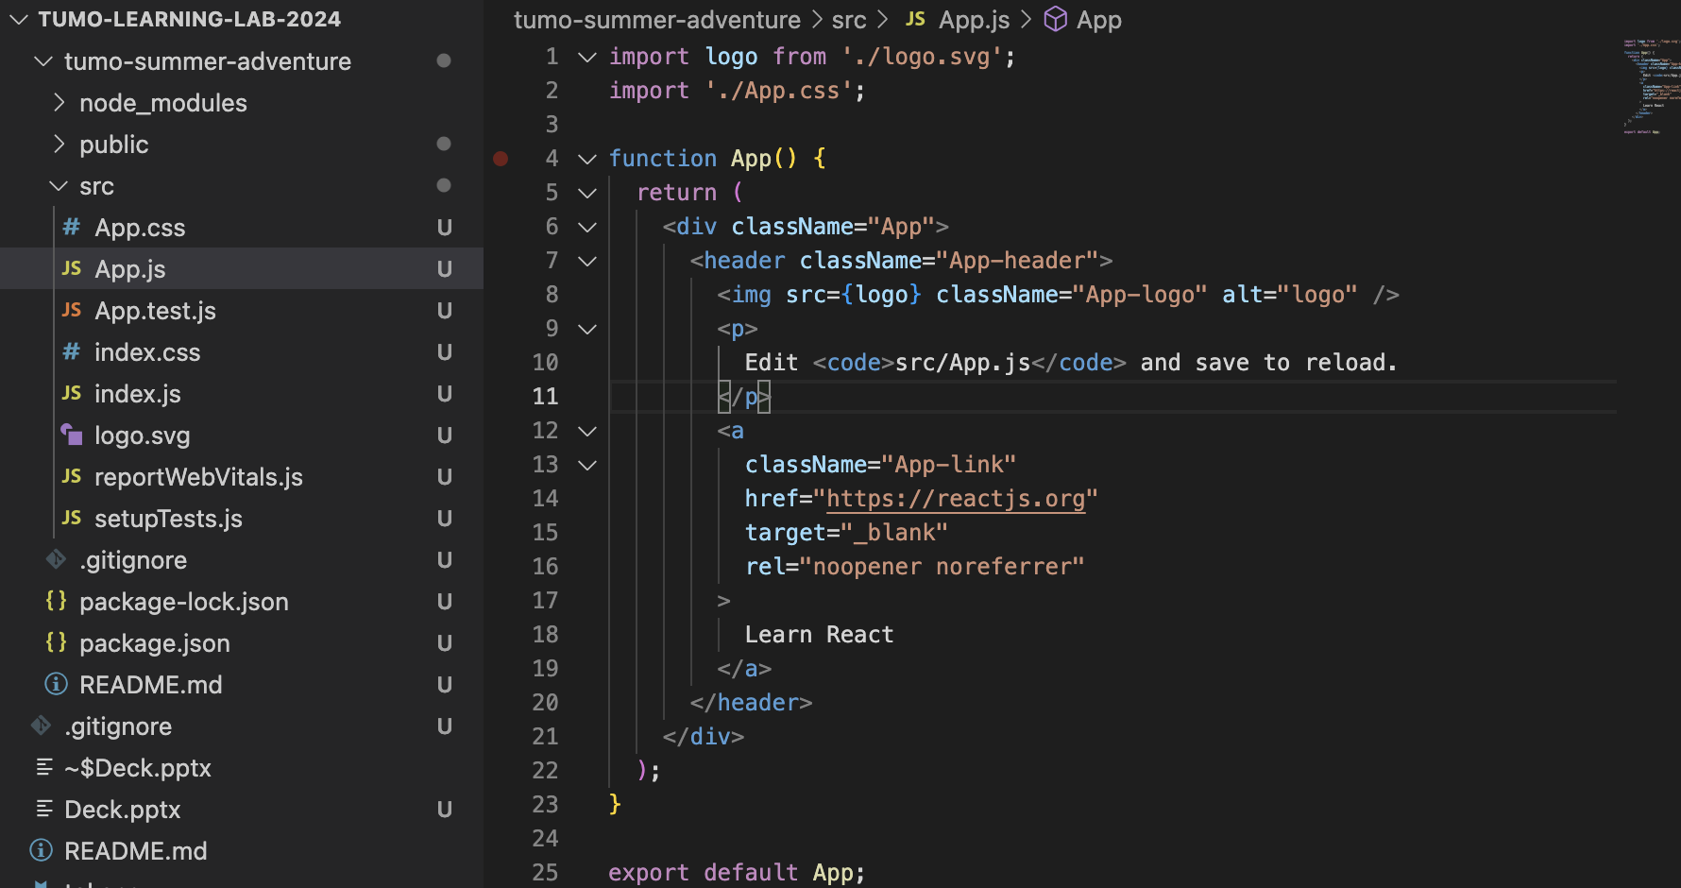
Monday – Day 6

Slide 100
GitHub
Monday – Day 6
Version control
Keep track of changes
See who pushed what

Slide 101
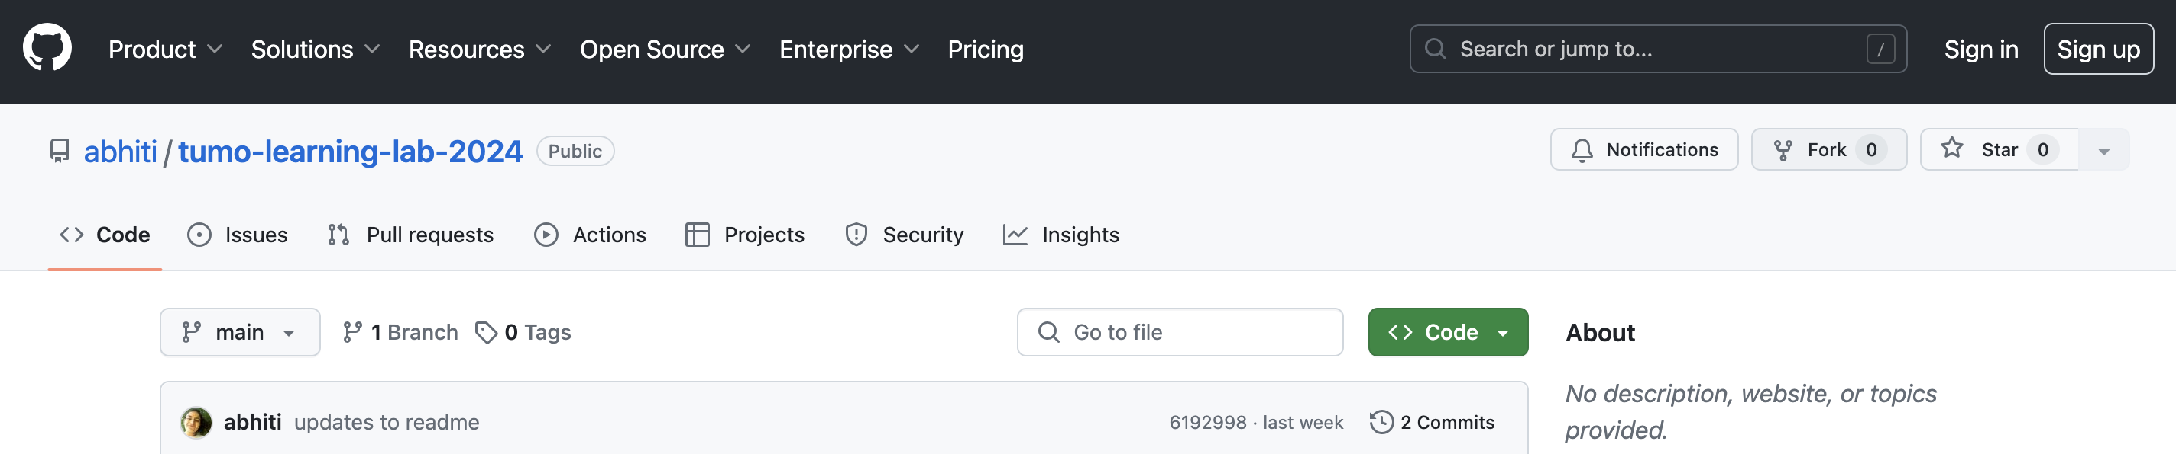
Dev Env Setup
Monday – Day 6
GitHub – version control
From Chrome, navigate to abhiti/tumo-learning-lab-2024
Log in
Fork repository
Clone forked repository to local machine $ git clone https://github.com/...
Make your changes
Change into the directory with your content $ cd /path/to/cloned/repo/tumo-learning-lab-2024
View the updates $ git status
Add all changes $ git add .
Label these changes $ git commit –m “lab day 6”
Send the updates to the remote repository (saving your changes to the internet) $ git push origin main
Push your updates after every lab (otherwise you will lose your progress)!
Notes:
lab4918m:tumo-learning-lab-2024 user$ git push origin main
Username for 'https://github.com’: <username>
Password for 'https://<username>@github.com':
remote: Support for password authentication was removed on August 13, 2021.
remote: Please see https://docs.github.com/get-started/getting-started-with-git/about-remote-repositories#cloning-with-https-urls for information on currently recommended modes of authentication.
fatal: Authentication failed for 'https://github.com/<username>/tumo-learning-lab-2024.git/'
lab4918m:tumo-learning-lab-2024 user$

Slide 102
Day 7 July 9, 2024
Tuesday – Day 7
REST APIs
Activity: Fetch calls from Chrome
Activity: Fetch call from React (>> Deliverable revision)
Ollama
Activity: Free play
Activity: Fetch call from React
Deliverable Revision
Activity: Project work

Slide 103
API
Tuesday – Day 7
Application Programming Interface (API): tool to exchange/modify data in a system
Eg. Withdrawing money from a bank account
Eg. Purchasing something online
Eg. Posting flight details on a monitor in the airport

Slide 104


API
Tuesday – Day 7
How much money do I have?
$300
Please withdraw $100
Done, your new balance is $200

Slide 105
REST API
Tuesday – Day 7
REpresentational State Transfer (REST): common type of API that defines a few “states” to perform CRUD operations
CRUD operations: Create, Read, Update, Delete
Every API has documentation on Internet

Slide 106
REST API - States
Tuesday – Day 7
GET: Retrieve data
POST: Create data
PUT: Update or create data
DELETE: Delete data
PATCH: Partially update data
HEAD: Retrieve headers
OPTIONS: Discover supported methods
TRACE: Echo the request
CONNECT: Establish a tunnel

Slide 107
API
Tuesday – Day 7
How much money do I have?
GET
$300
Please withdraw $100
POST
Done, your new balance is $200
user
server

Slide 108
REST API – GET via fetch
Tuesday – Day 7
Find an API, make a GET call from Chrome (using fetch)
Notes:
fetch('https://jsonplaceholder.typicode.com/posts/1') .then(res => res.json()) .then(console.log)

Slide 109
REST API – POST via fetch
Tuesday – Day 7
Find an API, make a POST call from Chrome (using fetch)
Notes:
fetch("https://jsonplaceholder.typicode.com/posts", {
// Adding method type
method: "POST",
// Adding body or contents to send
body: JSON.stringify({
title: "foo",
body: "bar",
userId: 1
}),
// Adding headers to the request
headers: {
"Content-type": "application/json; charset=UTF-8"
}
})
// Converting to JSON
.then(response => response.json())
// Displaying results to console
.then(json => console.log(json));

Slide 110
REST API – GET via fetch in React
Tuesday – Day 7
Find an API, make a GET in React
Look up documentation!
fetch('https://worldtimeapi.org/api/timezone/Asia/Yerevan')
.then(res => res.json())
.then(console.log)
Notes:
fetch('https://worldtimeapi.org/api/timezone/Asia/Yerevan')
.then(res => res.json())
.then(console.log)

Slide 111
OLlama
Tuesday – Day 7
Lllama – run open source LLama on your local machine
Ollama is the software that runs the model
Use Terminal to test
Otherwise keep server running and hit Llama via API

Slide 112
Tuesday – Day 7
Ollama – Server Running

Slide 113
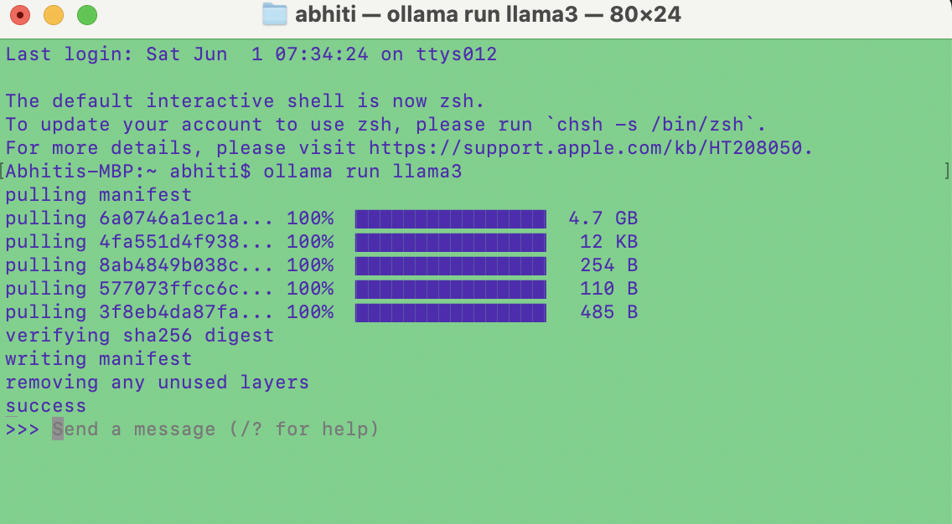
Tuesday – Day 7
Ollama – Test via Terminal

Slide 114
Ollama
Monday – Day 6
Prompt Ollama with a few different techniques in Terminal

Slide 115
REST API – POST via fetch in React
Tuesday – Day 7
Make a POST to Llama (using running Ollama server) from React

Slide 116
Deliverable Revision
Tuesday – Day 7
Example code

Slide 117
Project Work / Office Hours
Tuesday – Day 7
Continue making progress on your project
Match the HTML/CSS to Figma
Make API calls from React to the LLM to provide a response

Slide 118
Day 8 July 10, 2024
Wednesday – Day 8
Activity: working session/office hours

Slide 119
Day 9 July 11, 2024
Thursday – Day 9
Activity: working session/office hours

Slide 120
Day 10 July 12, 2024
Friday – Day 10
Activity: presentations!
Conclusion
Activity: reflections

Slide 121
APPENDIX

Slide 122
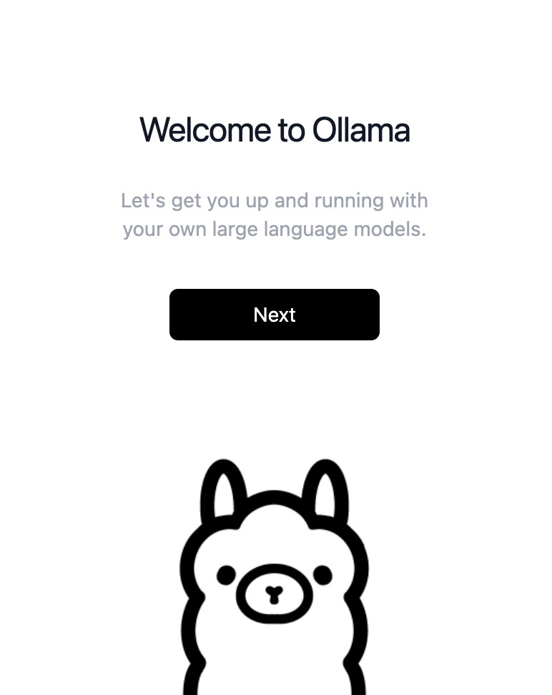

Slide 123
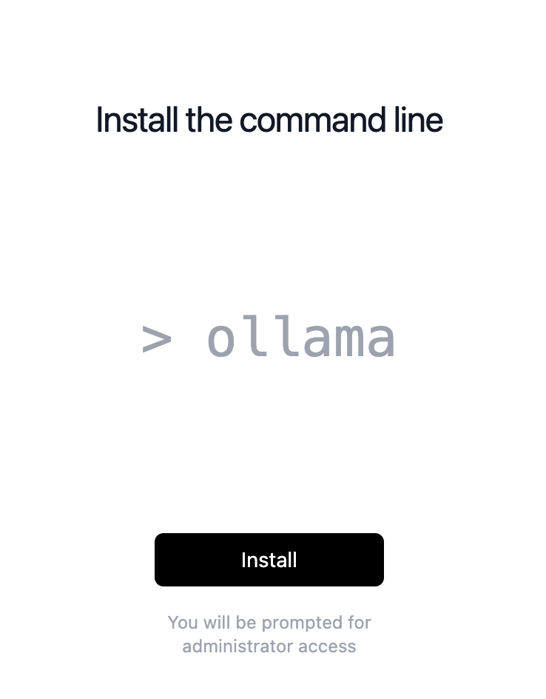

Slide 124
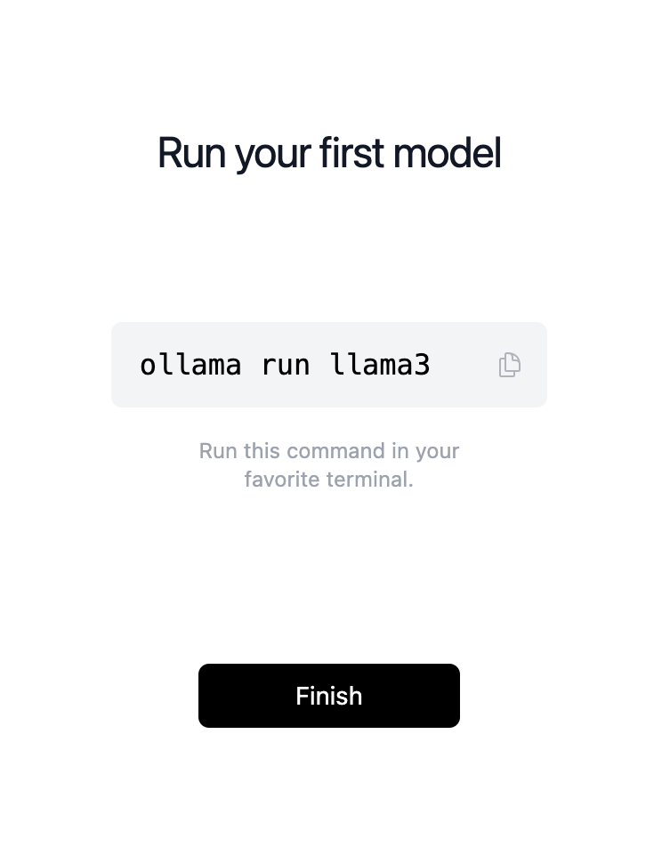

Slide 125
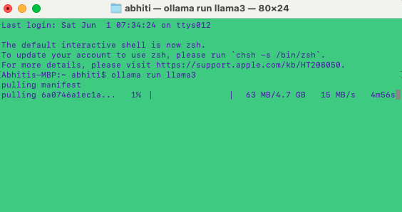

Slide 127
Monday
Tuesday
Wednesday
Thursday
Friday

